Slide 1
Colonialism Through Political Cartoons, c. 1900
Professor Felber-Seligman
Africa and the Modern World
Spring 2020

Slide 2
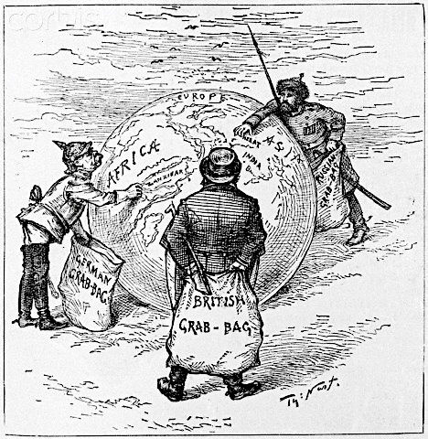

Slide 3
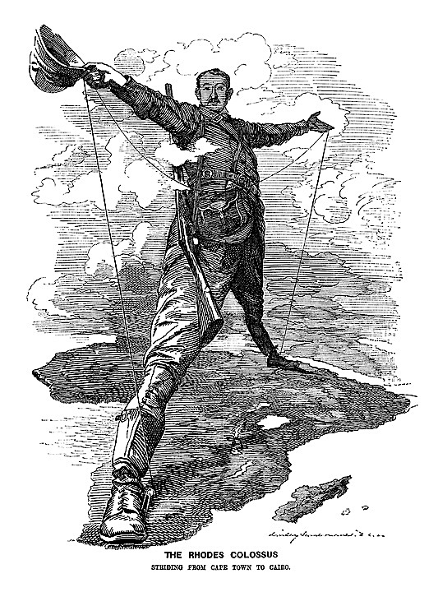

Slide 4
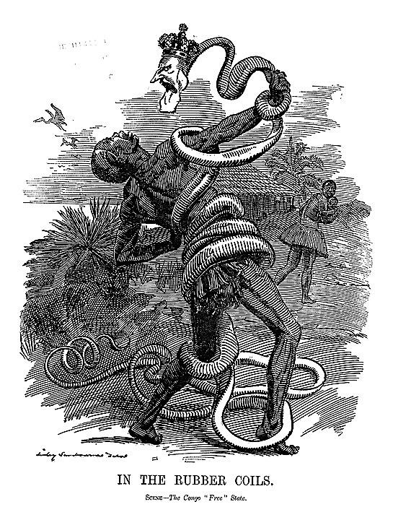

Slide 5
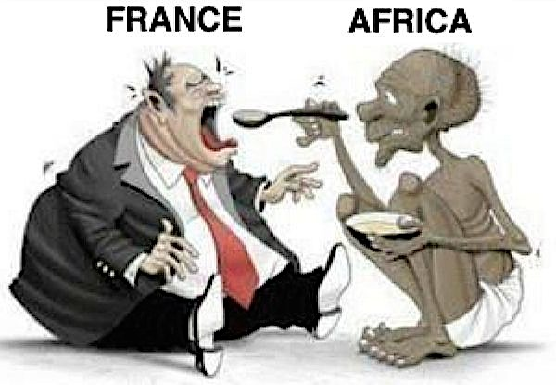

Slide 6
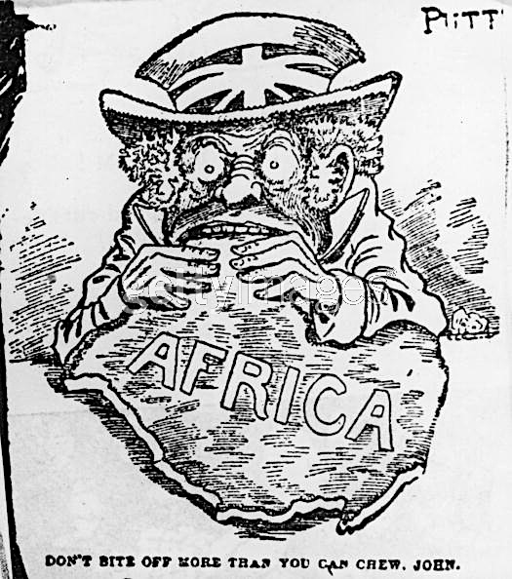

Slide 7
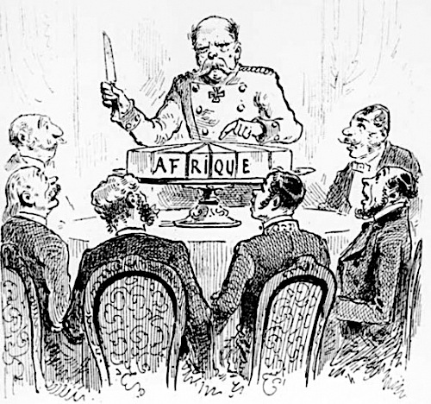

Slide 8
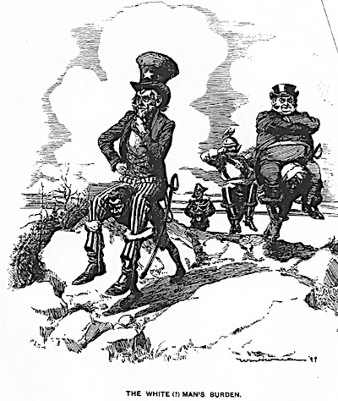

Slide 9
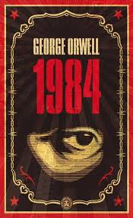
Other facets of Colonialism
Control of minds and bodies
Control of knowledge and education
Ex. Major changes in ideas of “proper” women’s roles in this period

Slide 10
Chronologies
Complex era of Afro-European contacts c. 1400-1800s
Mid to late 1800s imperialism
Conference of Berlin 1894-5
Formal Colonialism c. 1880s-1960s

Slide 11
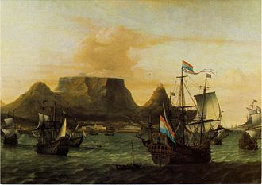

Settler Colonies:
Example South Africa
1652
VOC
Dutch supply station

Slide 12
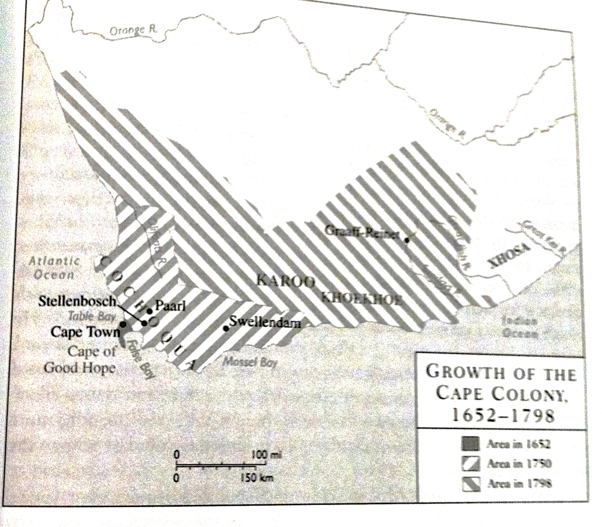

Slide 13
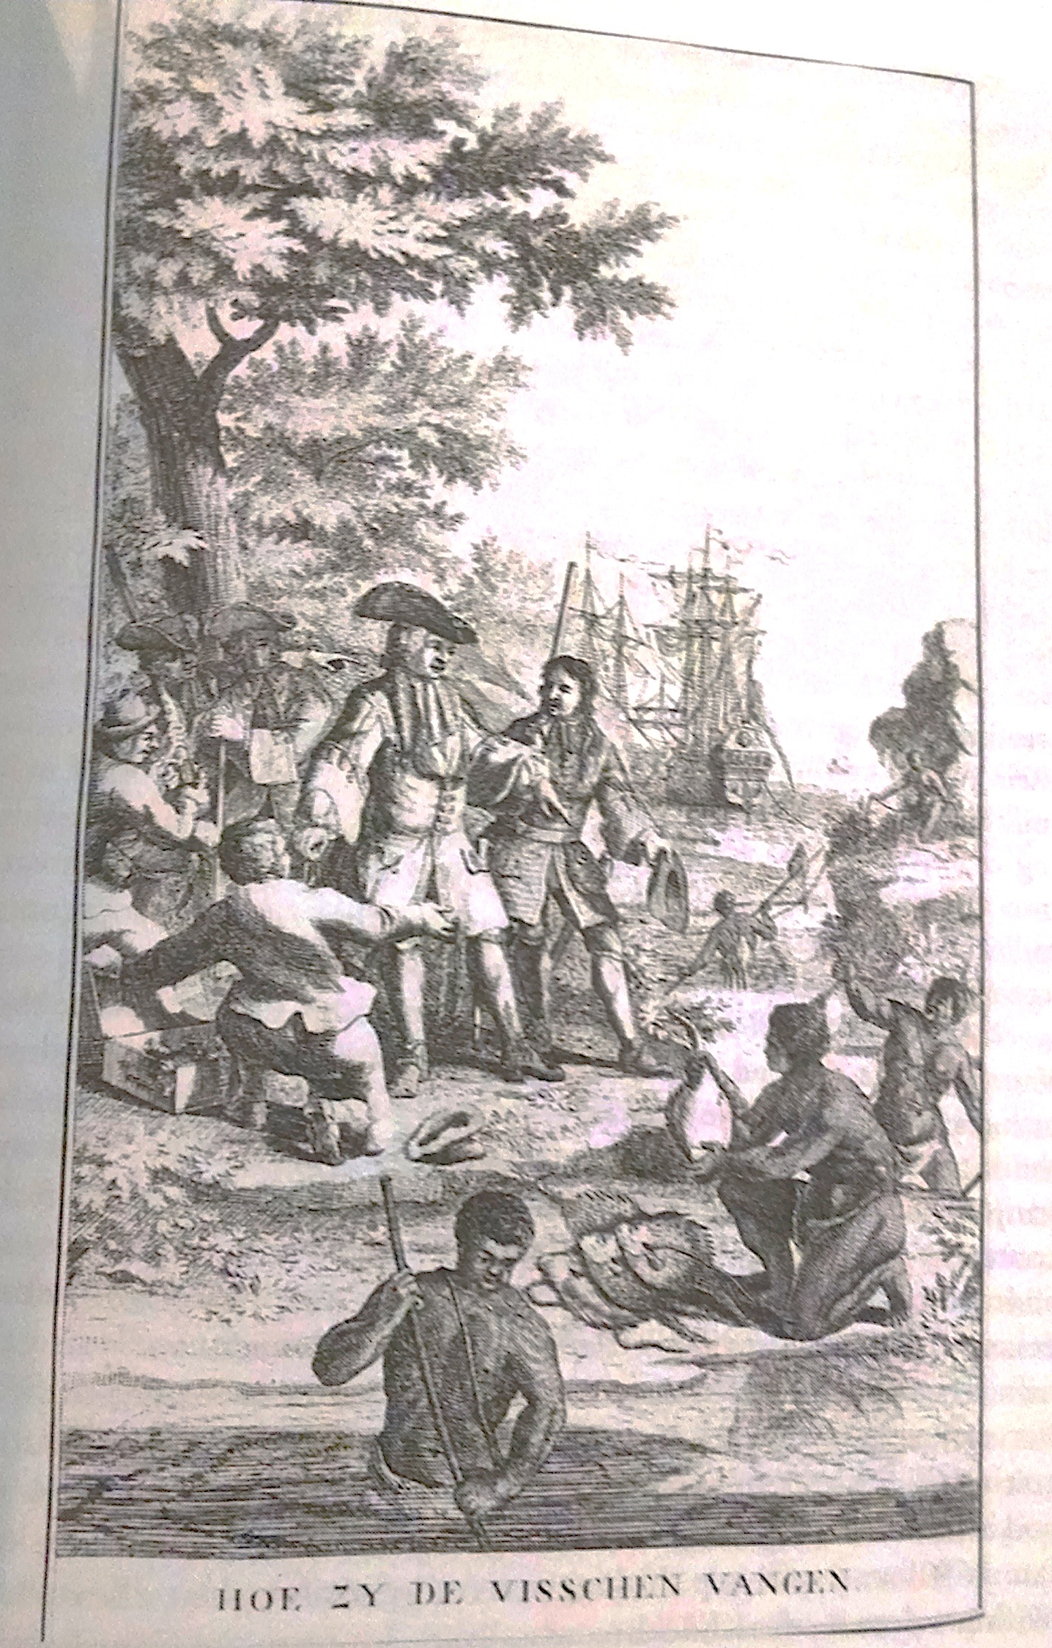
Tensions between Dutch settlers (called Boers) and indigenous Africans known as Khoisans

Slide 14
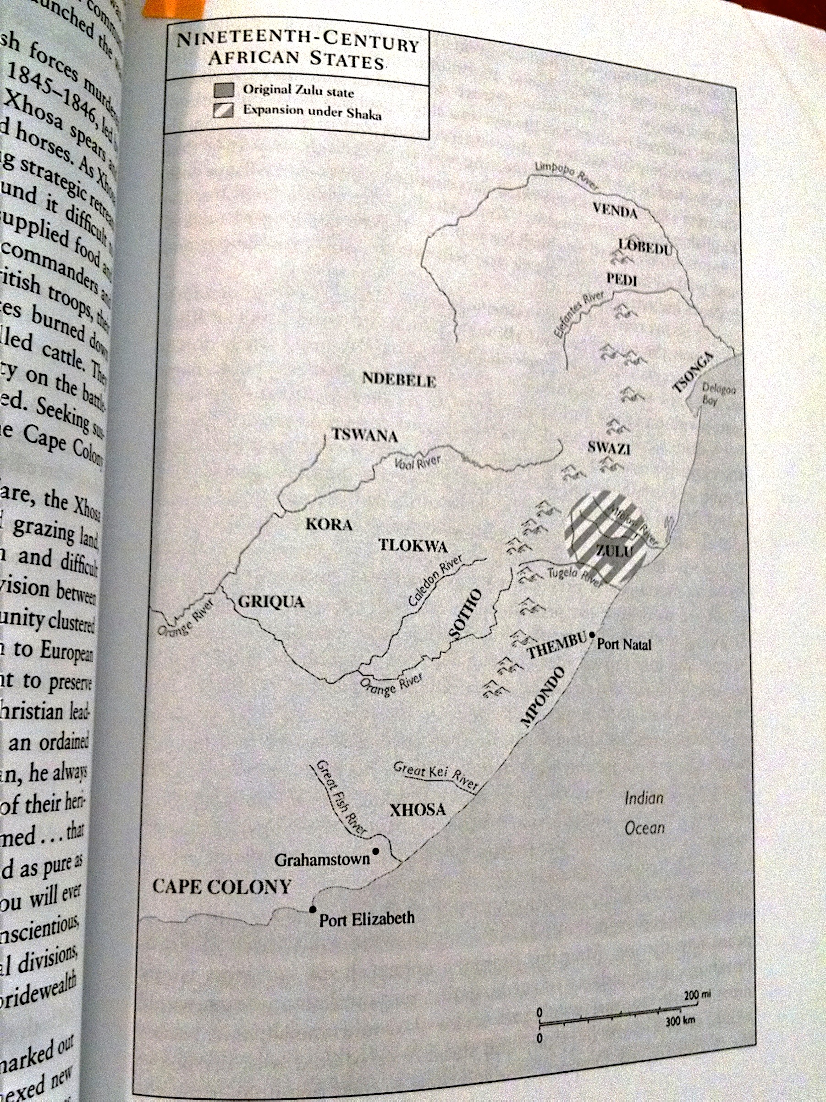
Wider area home to large and small African states

Slide 15
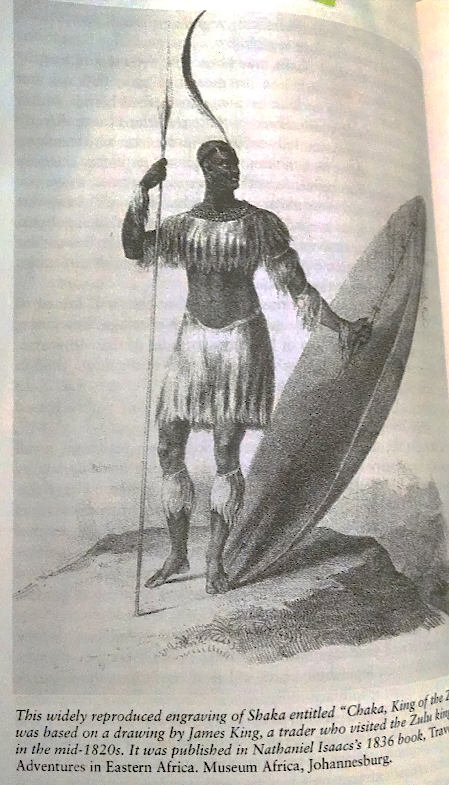
Famous centralized Zulu Kingdom under King Shaka early 1800s

Slide 16
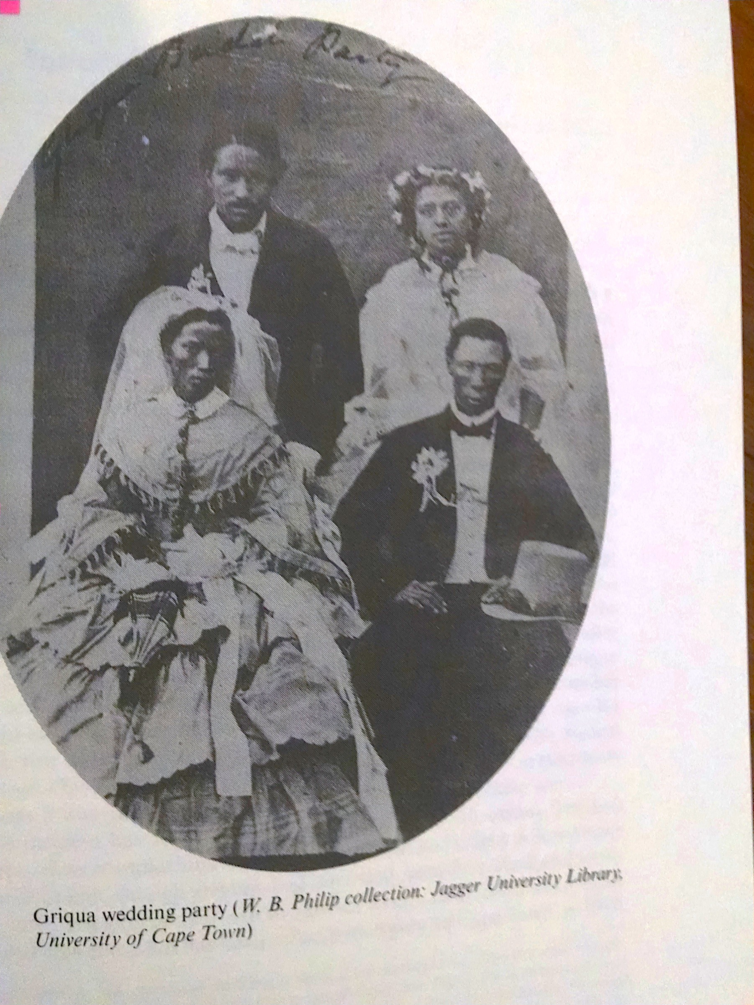
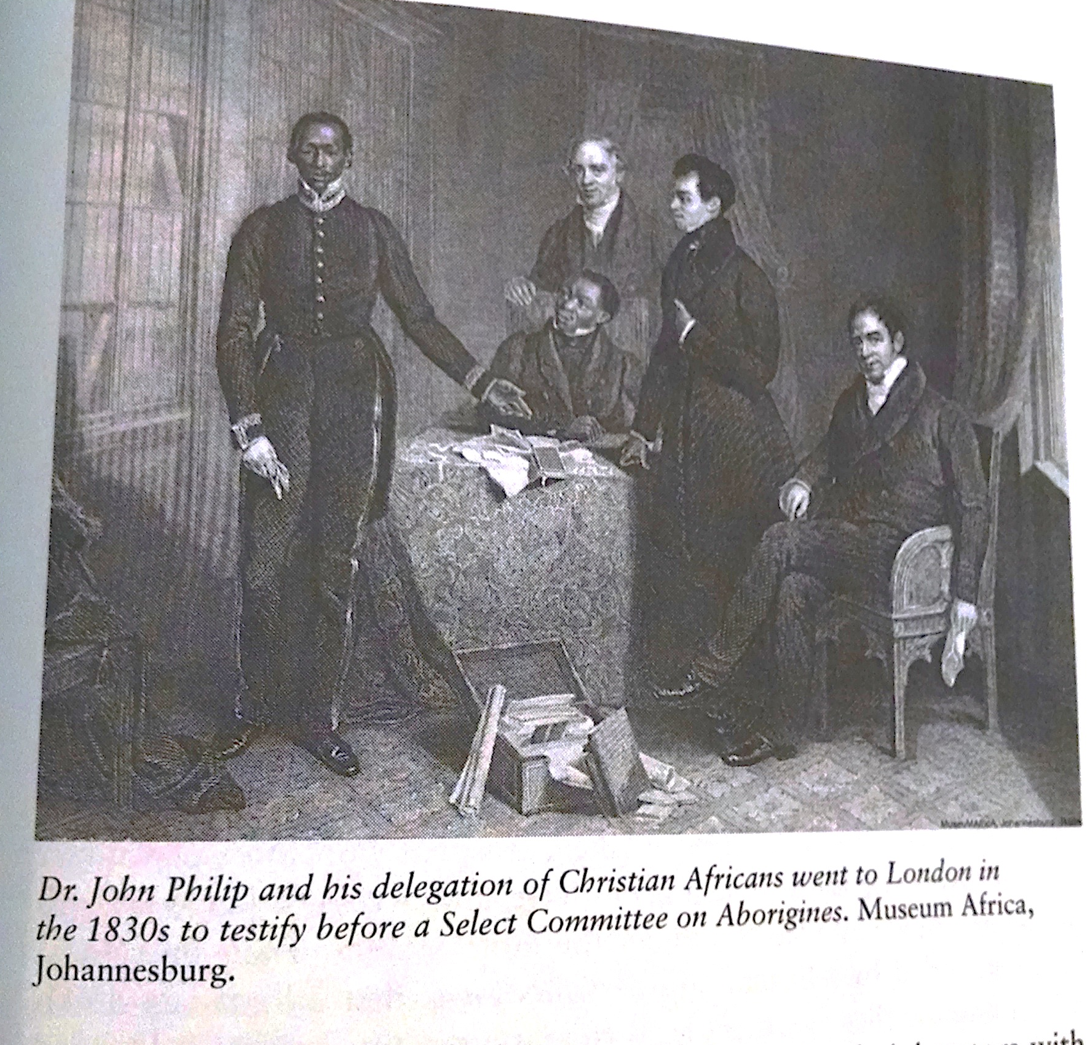
Urban Cape Colony Culture: possibilities for equality?

Slide 17
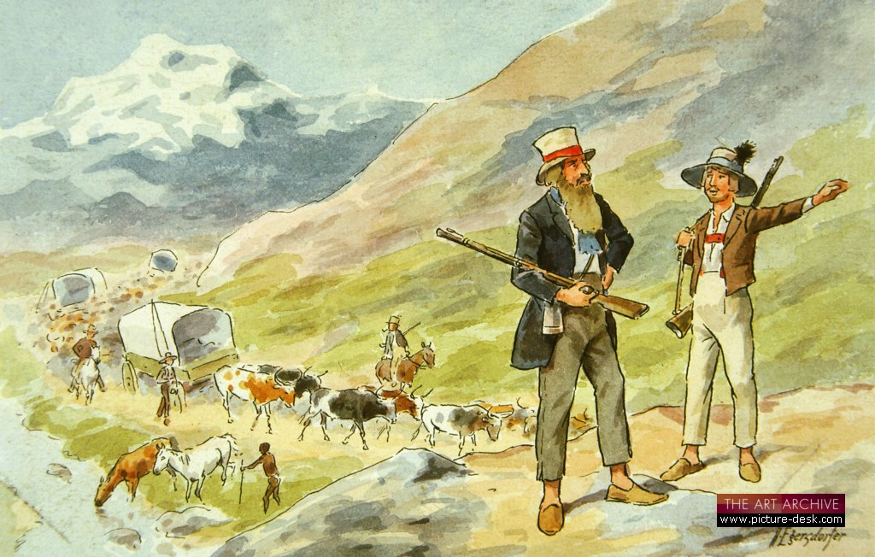
The Boer Trekkers c.1836-1840

Slide 18
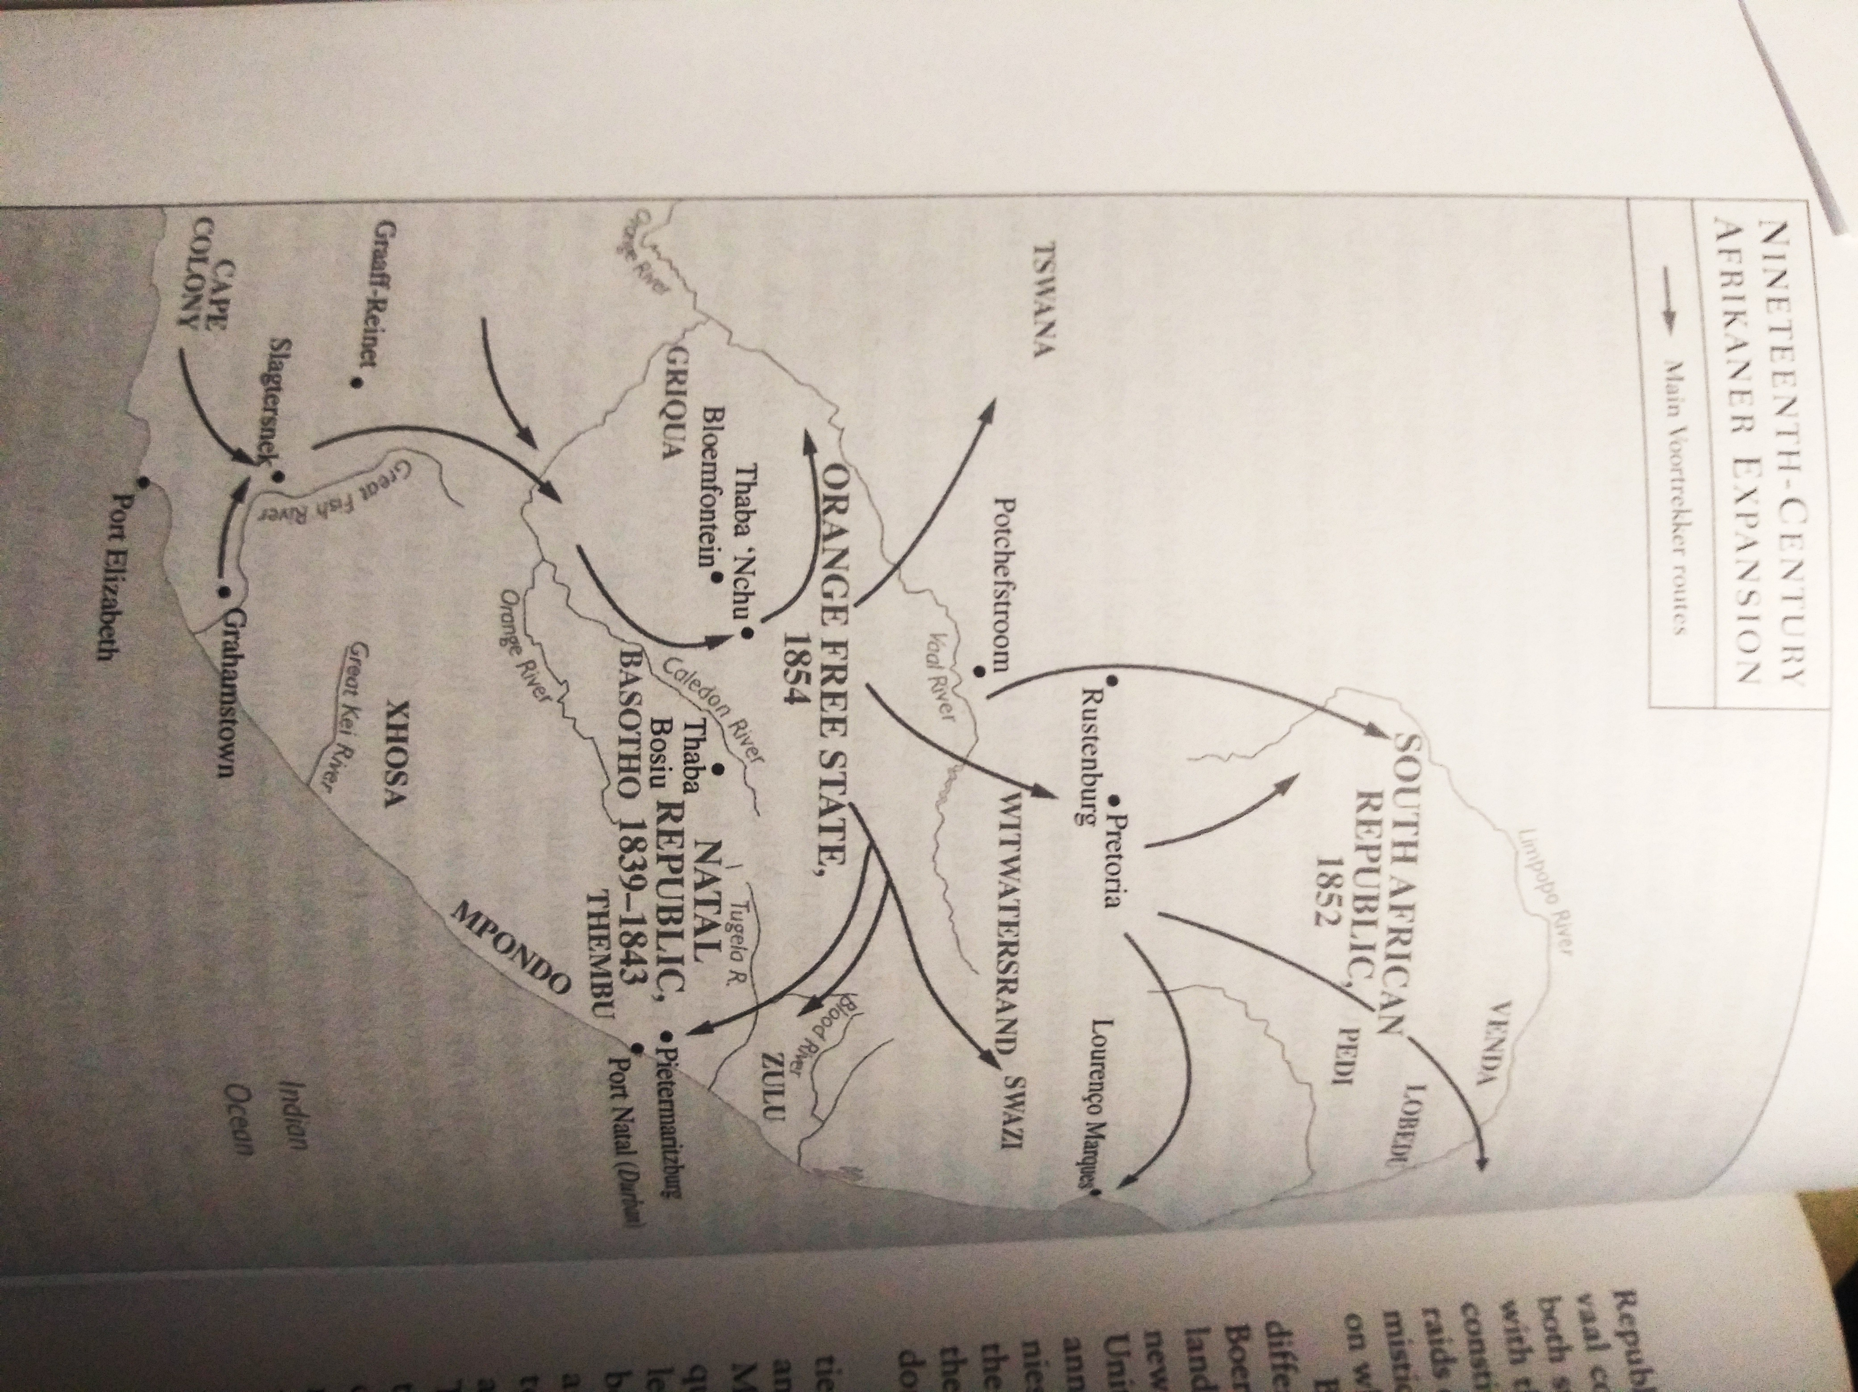
1834 Enslaved people emancipated in Cape Colony
1836-1840 Great Trek
1852 & 1854 Separate Afrikaner colonies of Orange Free State & Transvaal

Slide 19
Expansion by Boers into previous African territory
Also English expansion in Natal for trading prospects
Autonomy & independence of African leaders under threat
New ideas of who can own property & manage governments

Slide 20
Tipping points: mid to late 1800s

Slide 21
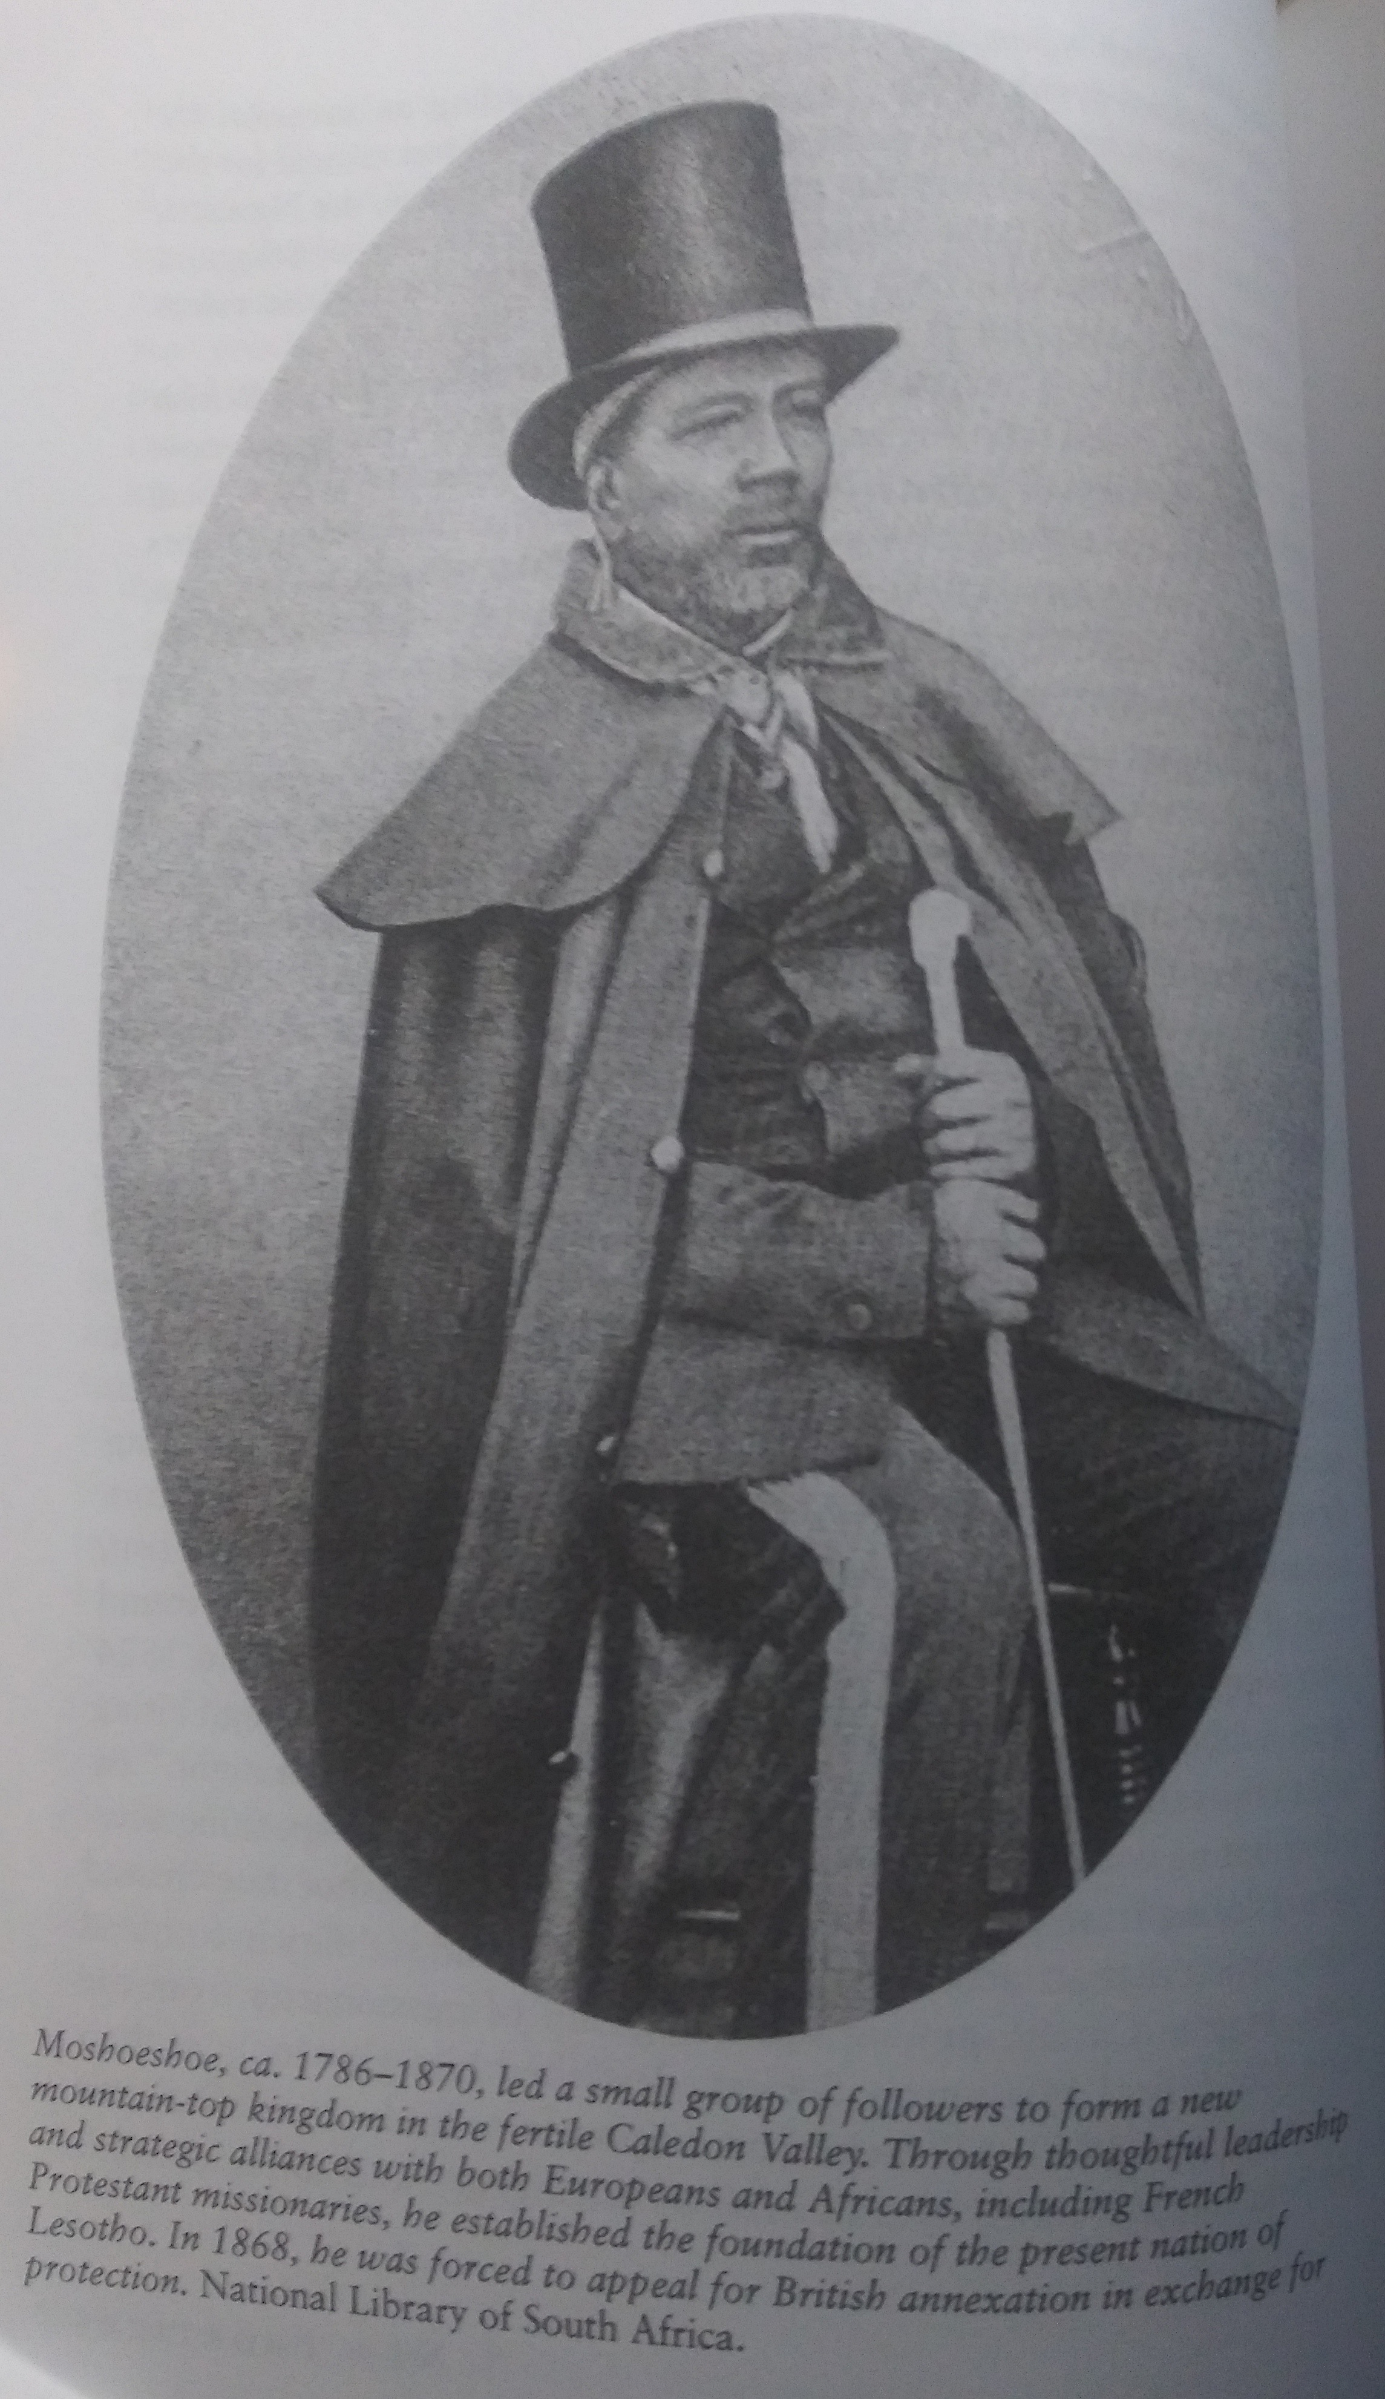
Leader Moshoeshoe c. 1786-1870 and Kingdom of Lesotho

Slide 22
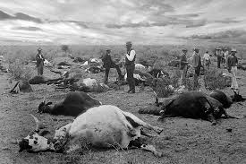
Rinderpest (cattle plague) epidemic

Slide 23
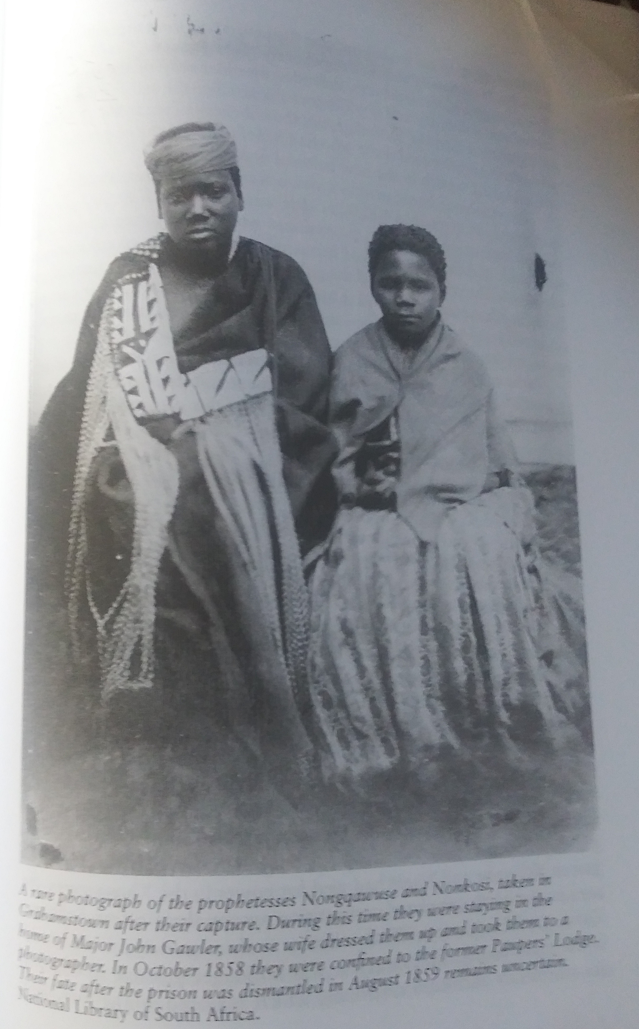
Spiritual Leader Nongquawuse, c. 1850

Slide 24
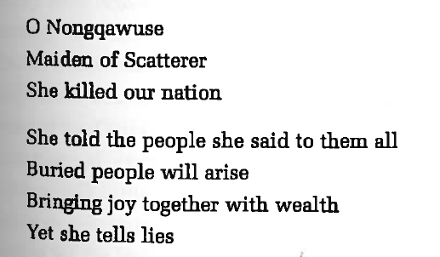
Qtd in Helen Bradford, “Not a Nongqawuse Story: An Anti-Heroine in Historical Perspective,” in 43..

Slide 25

And then…

Slide 26
New Mineral Rush
1867: Diamonds Discovered in Griqualand West
1866 Gold Discovered on the Witwatersrand
Accelerated interest in controlling all of South Africa as European colony
After multiple wars, British establish rule in 1902

Slide 27


Slide 28
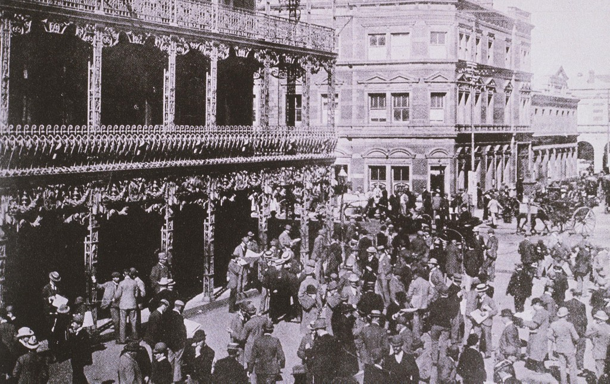
Early Johannesburg

Slide 29
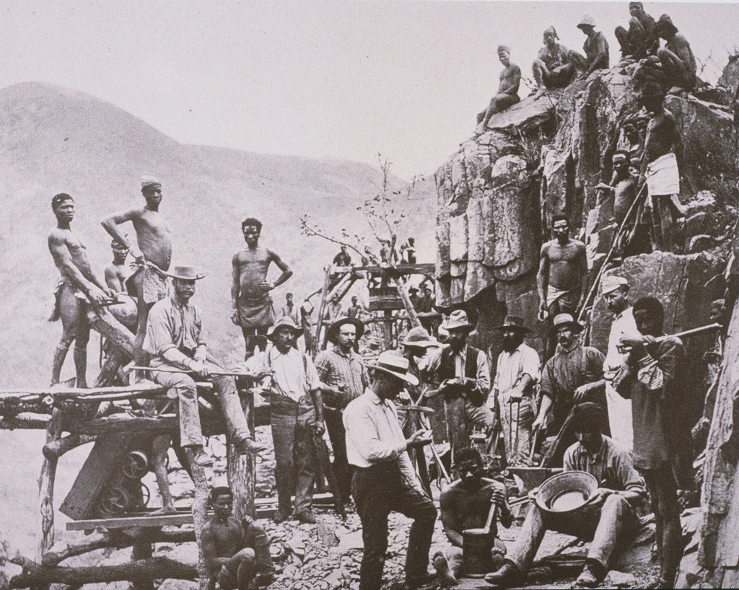
Prospectors c. 1880s

Slide 30
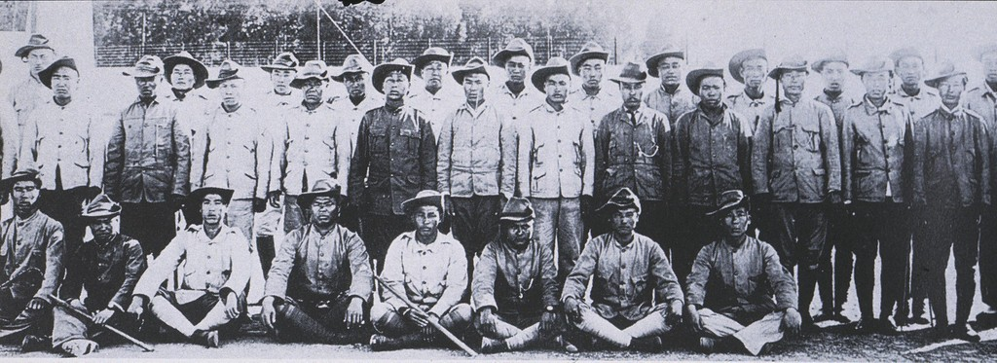
Chinese Laborers, South Africa

Slide 31
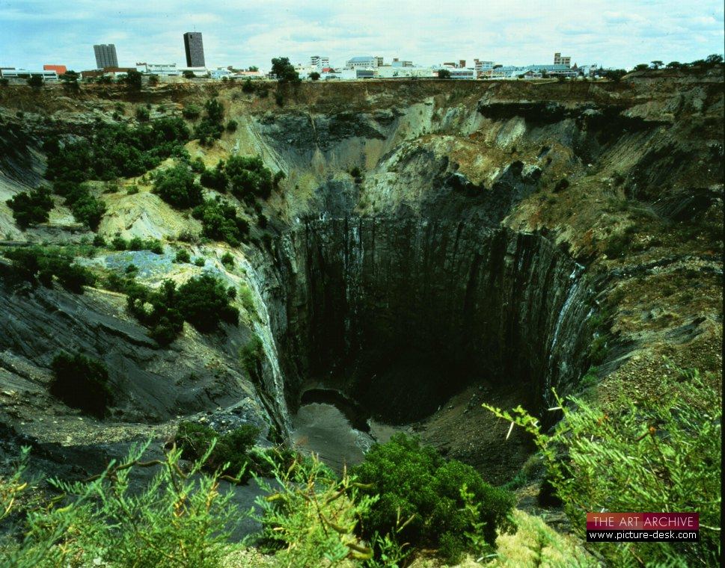
De Beers consolidated mines

Slide 32
20th Century Historical Memory in Music: Song “Stimela!” by Hugh Masekela
There is a train that comes from Namibia and Malawi
There is a train that comes from Zambia and Zimbabwe
There is a train that comes from Angola and Mozambique
From Lesotho, from Botswana, from Swaziland
From all the hinterlands of Southern and Central Africa.
This train carries young and old men who are conscripted to come and work on contract
In the Gold and Mineral mines of Johannesburg and the surrounding provinces and Metropolis
16 hours or more a day, for almost no pay.
Deeeeeeep, deeeeeep deeeeep, deeeeeep, deeeeeep, deeeep Deeeep,deeep, deep, down in the belly of the earth
When they’re digging and drilling for that shiny mighty evasive stone.
Or when they dish their mish-mash-mush food Into their iron plates With their iron shovel. Or when they sit in their stinky, filthy, funky, flee-ridden barracks and hostels
And they think about their loved ones they may never see again,
Because they might have been forcibly removed from where they last left them
Or wantonly murdered in the dead of night
Youtube link 1993 recording: https://www.youtube.com/watch?v=7lMQWnRBQr0

Slide 33
Lyrics continued to “Stimela!”
By raving and marauding gangs of no particular origin – we are told!
They think about their land and their herds that were taken away from them,
With the gun and bomb and the teargas and the Gatling and the canon,
And when they hear that chu-chu train –
Smoking and-a-pushing and-a-climbing
And-a-toting and and-a-steaming and-a-crying
And-a-moaning and-a-pushing and-a-grumbling
And-a-moaning and-a-climbing and-a-crying
And-a-screaming and-a-squishing
And-ah-whooooooooo Whoooooooooo!
They always curse, and they curse the coal train,
The coal train that brought them to Johannesburg.
Stimela. Ahhh

Slide 34
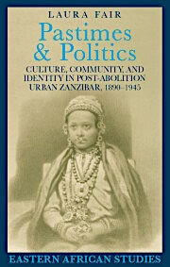
Reading Preview
Start reading for Thursday’s class
Think about popular culture & protest
Your Paper 3 assignment (due May 7) will ask you to explore an example of the connections between popular culture & protest
Many examples in this book from sports to fashion to informal collective protests
Decide what interests you and read strategically for examples in this book
LIBRARY EBOOK. Read online or download.

